Slide 1
RDA Serials Cataloging: Changes from AACR2 to RDA
Renette Davis
With thanks to Judith Kuhagen, Library of Congress
Last updated: Oct. 6, 2010

Slide 2
Training documentation
Library of Congress Documentation for the RDA (Resource Description and Access) Test
http://www.loc.gov/catdir/cpso/RDAtest/rdatest.html
Notes:
The Library of Congress has set up a Web page at the URL shown here with training materials for RDA , and it is available to everyone. It includes a link to training materials for RDA test participants, which is also available to everyone. On that page is a link to a Webcast that was given by Barbara Tillett on January 12, 2010, called RDA Changes from AACR2 for Texts.
Also on that page is a link to the Train-the-Trainer workshop that was given by Barbara Tillett and Judy Kuhagen on January 15. This is the webcast that we used for training at The University of Chicago on Aug. 18 and 19, 2010.
At the URL on this page there are also links to LC core RDA elements, choices in RDA, examples of RDA records, and Library of Congress Policy Statements, all of which are available to everyone.

Slide 3
Training documentation (cont'd)
Joint Steering Committee for Development of RDA
Presentations on RDA
http://www.rda-jsc.org/rdapresentations.html
Notes:
The Joint Steering Committee for Development of RDA has also set up a Web page with presentations that have been done on RDA.
On that page is a link to a presentation that Adam Schiff gave at the British Columbia Library Association Preconference on April 22, 2010. It is an excellent presentation containing many examples from AACR2 and RDA with the changes marked in red.
Also on that page is a link to a presentation that Robert Maxwell gave to the Utah Library Association on May 14, 2010. It is also an excellent presentation with general information on RDA as well as specific examples of differences between AACR2 and RDA.

Slide 4
University of Chicago documentation
http://www.lib.uchicago.edu/staffweb/depts/cat/rda.html
http://www.lib.uchicago.edu/staffweb/depts/cat/rda/
ChangingAACR2recordstoRDArecords.pdf
http://www.lib.uchicago.edu/staffweb/depts/cat/rda/
rdaexamples.pdf
Notes:
Here are some URLs for University of Chicago documentation relating to the RDA test. The main page includes links to Library of Congress Documentation and RDA Testers Documentation. It also includes a U of C Timeline for RDA Testing and University of Chicago's Decisions on Choices in RDA.
We created a cheat sheet called Changing AACR2 Records to RDA Records which includes things that we thought would be different in RDA, based on the 2008 draft and on various training documents that we had seen. Feel free to use this any way you want, but remember that it is not authoritative. It was created before RDA was released and there are lots of things that we didn't know yet. The records that we created using this cheat sheet were just to enable us to start the conversation with public services staff about displays.
We also created an RDA Examples page. Again, feel free to use any of these examples however you want, but remember that we really didn't know what we were doing when we created these records. We had lots of questions as we were doing them and we probably made a lot of mistakes. But it at least gave our public services staff something to look at so they could be thinking about displays. There are links to MARC views as well as PAC views, and they are live, so as we learn more and revise the records, you can see the changes in the examples.

Slide 5
GMD replaced by 336, 337, & 338
AACR2
245 $a Regional database. $p Central Asia $h [electronic resource].
RDA
245 $a Regional database. $p Central Asia.
336 $a text $2 rdacontent
337 $a computer $2 rdamedia
338 $a online resource $2 rdacarrier
Notes:
One big difference between AACR2 and RDA is that in RDA, there will no longer be a GMD like [electronic resource] or [microform] following the title. Instead there will be three new fields: 336 for Content type, 337 for Media type and 338 for Carrier type.
Content type reflects the fundamental form of communication in which the content is expressed. Media type reflects the general type of device that is required to use the resource and carrier type reflects the specific format of the storage medium that is required.
This slide shows how the title looks in an AACR2 record with a GMD of [electronic resource], and then how it looks in an RDA record, which has no GMD, but a 336 for content type of text, a 337 for media type of computer, and a 338 for carrier type of online resource.

Slide 6
Marks of omission & abbreviations
AACR2
110 $a Friends of the Bodleian.
245 $a Annual report ...
300 $a v. : $b ill. facsims. ; $c 26 cm.
RDA
110 $a Friends of the Bodleian, $e author.
245 $a ... Annual report ...
300 $b illustrations, facsimiles ; $c 26 cm
Notes:
In AACR2, we are used to seeing marks of omission in the middle of the title, or at the end of the title, but not at the beginning of the title. In RDA, we will also have marks of omission at the beginning of the title in cases like this, where the title is First annual report 1925-26.
You'll notice that in the RDA record, we have a relationship designator in the 110. Relationships are important in RDA but the relationship designator is not a core element. This shows the relationship between the corporate body and the resource. It is given only in the bibliographic record, not in the name authority record for the corporate body.
We don't have a 300 $a in the RDA record because it is not required for serials unless the title has ceased. If we had included it, it would be volumes instead of v period.
We applied the alternative to include facsimiles in addition to illustrations, and you'll notice that they are both spelled out in the $b in the RDA record. There is no period after cm in $c because cm is considered a symbol, not an abbreviation, and because there is no series statement in this record. The series area is preceded by a full stop in ISBD, so if there were a series statement, there would be a period at the end of the 300.

Slide 7
No supplied other title information
AACR2
111 $a Conference on Tax Planning for 501(c)(3) Organizations.
245 $a Conference on Tax Planning for 501(c)(3) Organizations : $b [proceedings].
RDA
111 $a Conference on Tax Planning for 501(c)(3) Organizations, $j author.
245 $a Conference on Tax Planning for 501(c)(3) Organizations.
500 $a Proceedings of the conference.
Notes:
In AACR2, if the title needed explanation, such as when it consisted only of the name of a corporate body or conference, a brief addition was supplied in brackets as other title information. RDA has no provision for that, so there is no $b [proceedings] in the RDA record.
In lieu of that, we can give the RDA element "Nature of the content“ as a 500 note, which we have done here.
You'll notice that the relationship designator for the 111 is in $j instead of $e as it was in the 110 on the previous slide. The same would be true for a 711. That's because $e for 111 and 711 is Subordinate unit.

Slide 8
Edition statement as on resource
AACR2
245 $a Information Moscow.
250 $a Western ed.
260 $a San Francisco, Calif. : $b U.S. Information Moscow, $c c1987.
RDA
245 $a Information Moscow.
250 $a Western edition.
260 $a San Francisco, California : $b U.S. Information Moscow, $c [1987?], ©1987.
Notes:
In AACR2, we abbreviated edition in the Edition statement, but in RDA we will spell it out if that's the way it is on the resource. If it had been abbreviated on the resource, then we would have had Western ed.
We would also have had an extra period after the "ed" if the abbreviation was present on the resource because under new ISBD guidelines, when an element or area ends with a full stop, the full stop for prescribed punctuation is also added.
You'll notice that California in the 260 $a is not abbreviated in the RDA record because it is spelled out on the piece. Again, if it had been abbreviated on the piece, it would have been abbreviated in the 260.
In AACR2 if there was no date of publication, but there was a copyright date, we could use the copyright date preceded by c in lieu of the publication date. In RDA, we would not do that because the copyright date is a separate element. If there is no publication date, RDA encourages supplying a probable date of publication. If we can't do that for monographs we would say [date of publication not identified] followed by the copyright date. For serials and integrating resources, if the date of publication cannot be approximated, we don't give the date. In other words, we don't have to use [date of publication not identified] for serials and integrating resources.

Slide 9
Publisher as on resource
AACR2
245 $a Filmfare annual.
260 $a Mumbai : $b Bennett Coleman & Co.
300 $a v. : $b col. Ill., ports. (some fold-out) ; $c 28 cm.
RDA
245 $a Filmfare annual.
260 $a Mumbai : $b Bennett Coleman & Co. LTD
300 $b colored illustrations, portraits (some fold-out) ; $c 28 cm
Notes:
In AACR2, we gave the name of the publisher in the shortest form in which it could be understood, but in RDA we will transcribe the publisher as it appears on the source of information, although there is an option to omit levels in a corporate hierarchy. In this case, we have added LTD to the publisher's name since that's the way it appears on the piece. Company was abbreviated on the piece, but if it had not been, we would have spelled it out in the RDA record.
Again, we don't have a 300 $a in the RDA record because it is not required for serials unless the title has ceased, but if we had included it, it would be a number followed by volumes instead of v period.
We are still including 300 $b and $c at The University of Chicago, even though it is not required for the CONSER Standard Record. However, we no longer abbreviate colored illustrations as col. ill., or portraits as ports. in the 300 $b.
Again, notice that there is no period after cm in the 300 $c because cm is considered a symbol instead of an abbreviation. However, if there had been a series statement in this record, we would have included the period because the series area is preceded by a full stop in ISBD.

Slide 10
No more [S.l. : s.n.]
AACR2
245 $a A Journal of natural philosophy, chemistry and the arts / by William Nicholson.
260 $a [S.l. : $b s.n., $c 1797-1813]
RDA
245 $a A journal of natural philosophy, chemistry and the arts / by William Nicholson.
260 $a [Place of publication not identified] : [publisher not identified], $c [1797-1813] ; $e (London : $f Printed by W. Stratford for the author)
Notes:
In AACR2, we used [S.l.] if there was no place of publication on the resource and [s.n.] if there was no publisher. RDA says to give a probable place of publication, and if that is not possible, use [Place of publication not identified]. If there is no publisher, we will use [publisher not identified].
If the place of publication is not available, then we are supposed to give the place of distribution, and if that is not available, then we are supposed to give the place of manufacture. Similarly, if the publisher is not available, then we are supposed to give the distributor, and if the distributor is not available, then we are supposed to give the manufacturer.
In this case we have the place where it was printed and the printer, so we have added those to $e and $f.
Notice that each subfield in the 260 is now in its own set of brackets. That's not actually an RDA change but an ISBD change.

Slide 11
Multiple media & carrier types
AACR2
245 $a ASOR : $b American Schools of Oriental Research newsletter.
(Electronic access added to print version record)
RDA
336 $a text $2 rdacontent
337 $a unmediated $2 rdamedia $3 print version
337 $a computer $2 rdamedia $3 electronic version
338 $a volume $2 rdacarrier $3 print version
338 $a online resource $2 rdacarrier $3 electronic version
Notes:
The University of Chicago uses a single record approach except for locally digitized resources, so this is a record for a print serial with online access added.
There is only one content type of text, but there are two media types and two carrier types. The media type of unmediated and the carrier type of volume apply to the print version, and the media type of computer and carrier type of online resource apply to the electronic version. We have used $3 to indicate which 337 and 338 apply to the print version and which apply to the electronic version.
Even though RDA recommends the separate record approach for multiple manifestations, it does seem like using media and carrier types like this makes it more clear what the record represents. I have had many people ask over the years if we could add a GMD of [electronic resource] to print version records where we have added access for the online version and of course I had to tell them no. However, we may be able to use the multiple media and carrier types in a creative way to indicate that we have both the print and online versions.

Slide 12
No abbreviations in 362
AACR2
245 $a Federal orrery.
300 $a 5 v. ; $c 43-47 cm.
362 $a Vol. 1, no. 1 (Oct. 20, 1794)-v. 5, no. 4 (Oct. 31, 1796).
RDA
245 $a Federal orrery.
300 $a 5 volumes ; $c 43-47 cm
362 $a Began with volume 1, number 1 (October 20, 1794); ceased with volume 5, number 4 (October 31, 1796).
Notes:
In the numbering area for serials, terms and months are to be transcribed as they are on the piece. If they are abbreviated on the piece, they would be abbreviated in the 362, but if they are spelled out on the piece, they would not be abbreviated as they would have in AACR2.
Numerals can be recorded according to the policy of the agency or as they are on the piece, so unless the agency decides to transcribe Roman numerals as Arabic, if it says volume X on the piece, that's the way it would be recorded in the 362.
An exception to recording numbers as they are on the piece is that numbers expressed as words are converted to numerals. That includes ordinal numbers such as first, second, etc.
RDA allows an unformatted note for Began with and Ceased with, even if we have the first or last issue in hand, as in the CONSER Standard Record.
Note that in this case, the title has ceased so we have the extent recorded in 300 $a, and it is 5 volumes instead of 5 v. Note also no period after cm in the 300.

Slide 13
No abbreviations in 362 (cont'd)
AACR2
362 0 $a Vol. 10, no. 1-
362 0 $a Vol. 1, no. 1-
362 0 $a Jan. 2010-
362 0 $a -n.s., v. 5.
RDA
362 1 $a Began with volume X, number 1.
362 1 $a Began with Vol. 1,
No. 1.
362 1 $a Began with:
Volume 1 ( January 2010).
362 1 $a Ceased with: new series, volume 5.
Notes:
Here are some more examples of changes in the way volume and date information may be represented in RDA. If captions and months are spelled out on the piece, they are spelled out in the 362. However, if they are abbreviated on the piece, then they would be abbreviated in the 362.
Numerals can be recorded as they appear on the resource or according to the policy of the agency. For the RDA test, we have decided this will be cataloger's judgment, so Volume X in this first RDA example is where the cataloger has chosen to record it as it is on the piece.
In the second example, volume and number were abbreviated and capitalized on the piece. The alternative at RDA 1.7.1 says that in-house guidelines can be used for capitalization, and the LCPS says that for capitalization, the cataloger can either "take what you see" on the resource or follow Appendix A.
The University of Chicago has decided for the RDA test to follow the LCPSs for PCC cataloging and to use cataloger's judgment for the non-PCC cataloging. My personal feeling is that it is going to be easiest if we just say to record 362 and 588 information exactly as it is on the resource, including capitalization, except in those few cases where RDA specifies otherwise.
As I mentioned in the last slide, RDA does not specify whether to use a colon or not in the unformatted 362. My personal preference is to do the same thing in the 362 and the 588, simply because that is easier to remember. I've shown examples both ways here. Again, I imagine CONSER will come up with some best practices regarding how to record the unformatted 362 and 588s.

Slide 14
Recording inclusive dates
AACR2
110 $a Friends of the Bodleian.
245 $a Annual report ...
362 0 $a 1st (1925/26)-
RDA
110 Friends of the Bodleian, $e author.
245 $a ... Annual report ...
362 1 $a Began with 1st (1925/1926).
Notes:
When recording inclusive dates and other inclusive numbers in RDA, both the first and last number are to be recorded in full. In this example, the date actually appeared as 1925-26 on the piece. AACR2 already allowed us to replace the hyphen with a slash. RDA tells us not only to replace the hyphen with a slash but also to repeat the 19 in the second year.
Notice again our ... at the beginning of the title in the RDA record. The ... before "Annual report" is for "first" and the ... after "Annual report" is for the "1925-26".

Slide 15
Reproductions
AACR2
245 $a Federal orrery $h [microform].
260 $a [Boston] Mass : $b Weld & Greenough, $c 1794-1796.
362 Vol. 1, no. 1 (Oct. 20, 1794)-v. 5, no. 4 (Oct. 31, 1796).
RDA
245 $a Federal orrery.
260 $a New Canaan, Ct. : $b Readex, $c 1983.
776 $i Reproduction of original print version: $t Federal orrery $d [Boston] Massachusetts : Weld & Greenough, 1794-1796. $h 5 volumes ; 43-47 cm.
Notes:
For reproductions, RDA says to describe the reproduction instead of the original resource. AACR2 actually also said that, but there was an LCRI which said to describe the original and make a note about the reproduction. This was a response to what libraries wanted at that time.
For the RDA test, LC has decided to follow RDA, so we created a record to see what it would look like. You'll notice that the 260 information is for the reproduction instead of for the original. There is a 776 field pointing to the original, which includes all of the subfields that we could in order to give information about the original resource.
We weren't sure whether to include 362 information in the RDA record, but one of the Library of Congress Policy Statements for the RDA test specifies that LC will catalog a reproduction of a serial as a serial rather than as a multipart monograph, which would be its true mode of issuance as a reproduction. Therefore, we think we can include the 362 information since it does appear on the reproduction. We also didn't know what to do with frequency, so we added a note that says, "Original publication issued as a semiweekly newspaper."
No decision has been made yet on what LC will do about reproductions if RDA is adopted, so we decided we really don't have to worry about this yet.

Slide 16
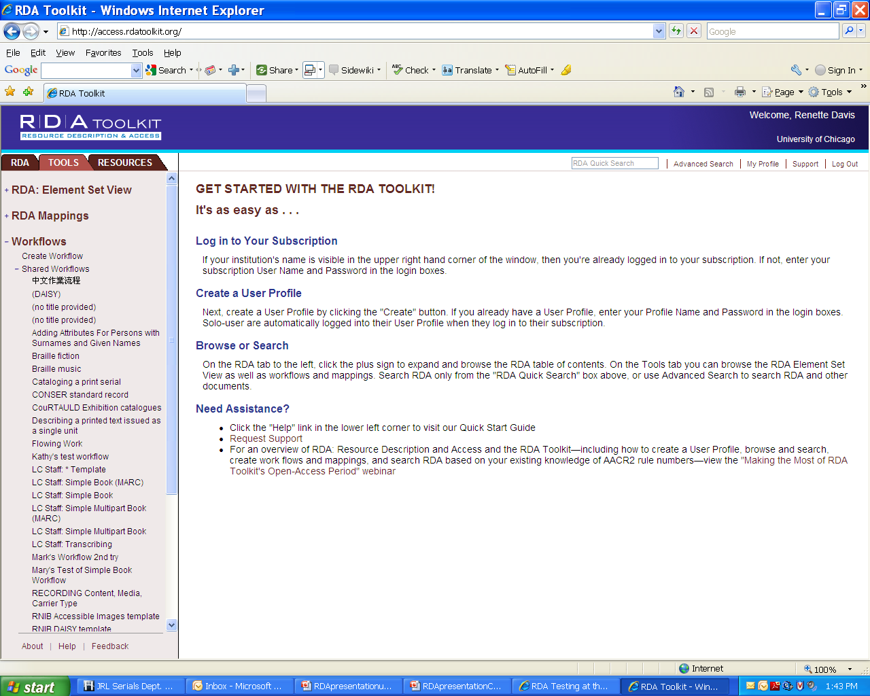
RDA Toolkit
http://access.rdatoolkit.org/
Notes:
This is the URL for the RDA toolkit. I have created a workflow called Cataloging a print serial, which walks you through the RDA rules that are used for the descriptive cataloging of a regular print serial. I don't know if you can see it on this screen shot, but it's under the Tools tab.

Slide 17
Full RDA Serial Record
Type a Elvl I Srce d Gpub Ctrl Lang eng
BLvl s Form Conf | Freq | Mrec Ctry miu
S/L 0 Orig EntW Regl | Alph
Desc i SrTp Cont DtSt c Dates 2009, 9999
040 CGU ǂb eng ǂc CGU ǂe rda
090 PN6727.D33G8
100 1 Davis, Guy, ǂd 1966- ǂe author.
245 10 Guy Davis artworks / ǂc Guy Davis.
260 [Michigan?] : ǂb [publisher not identified], ǂc [2009]- , ©2009-
300 ǂb chiefly illustrations (some color) ; ǂc 28 cm
336 still image ǂ2 rdacontent
336 text ǂ2 rdacontent
337 unmediated ǂ2 rdamedia
338 volume ǂ2 rdacarrier
362 1 Began with #1 (OCT 2009).
588 Description based on: #1 (OCT 2009); title from masthead.
588 Latest issue consulted: #1 (OCT 2009).
600 10 Davis, Guy, ǂd 1966-
650 0 Cartoonists.
650 0 Comic books, strips, etc.
856 42 ǂu http://www.guydavisartworks.com/
Notes:
Here is the first RDA record that I created from scratch. It's kind of a weird serial, so not only was I not sure about some things relating to RDA but I wasn't sure about a number of things related to cataloging this resource. I did not make it CONSER because of these uncertainties.
The title itself does not appear on the cover or what looks like it could be a title page, but only in the masthead. On the cover is Guy Davis in large red print, and then beneath that in smaller font is www.guydavisartworks.com. In the masthead, the title appears as GUY DAVIS ARTWORKS in all caps, followed by the numeration ( #1 / OCT 2009) with OCT also in all caps.
RDA 1.7.1 has an alternative which says that in-house guidelines for capitalization can be used instead of the instructions given in the rules at 1.7.2-1.7.9 or in the appendices. The LCPS says that for capitalization, the cataloger can either "take what you see" on the resource or follow Appendix A.
The University of Chicago has decided for the RDA test to follow the LCPSs for PCC cataloging and to use cataloger's judgment for the non-PCC cataloging. However, we also decided to change records coming from vendors, etc., if the title is all in caps, because we don't think our users would like the title all in caps for citation builders. Therefore, I decided not to use all caps in the 245.
However, I did decide to use all caps in the 362 and 588s. My personal feeling is that it is going to be easiest if we just say to record 362 and 588 information exactly as it is on the resource, except in those few cases where RDA specifies otherwise.
I did not add [distributor not identified] and [manufacturer not identified] to the 260 per LC guidelines to only address a missing sub-element for distribution or manufacturer if there was some sort of distribution or manufacturer information on the resource.

Slide 18
Thank you!
For questions or comments, send email to: rd13@renettedavis.com
Notes:
Feel free to use these slides however you want. Copy them, change them, add to them, delete parts, put them in your own template, whatever suits your needs. Please let me know if you see anything that needs to be corrected! Thanks!

